Slide 1
Add HTTPS to Your Website for Free in 15 Minutes!

Slide 2
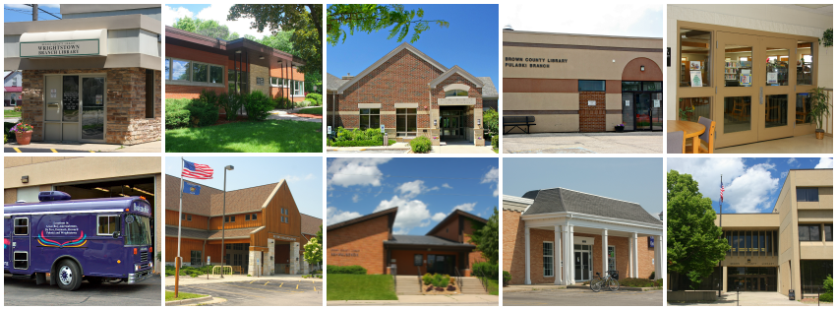
Me and My employer
Francis Beaumier
IT Specialist
Brown County Library, Green Bay, WI
Phone: 920-448-5863
Email: beaumier_fj@co.brown.wi.us
Pronouns: he/him/his

Slide 3
Why now?

Slide 4
Why now?
“Google is God. Don't Upset Her.”
Vincent Flanders, Web Pages That Suck

Slide 5
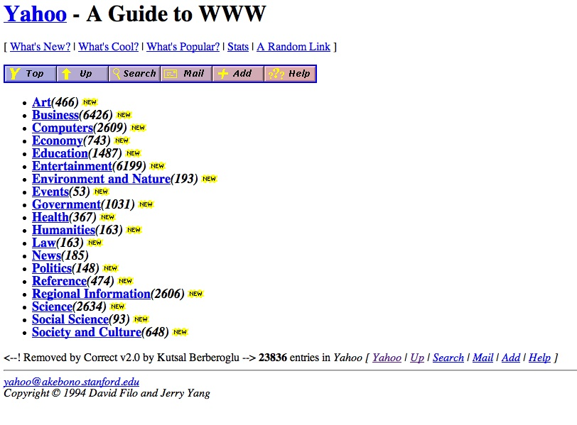
Why not before?
Things change

Slide 6
Why not?
$0 cost to you
Better privacy and security for your users
No downside for users*
* OK, so strictly speaking, yes there’s a downside for the users. You see, standards for encryption are constantly evolving as we get better and better at theses sorts of things. That means retiring older standards. So yes, you will leave behind users on older operating systems that cannot support never versions of encryption. But I mean, we’re talking Windows XP here – we’re not talking about last year’s operating system. You gotta leave some people behind some of the time. I mean really, when was the last time you actually sat down and tested your Web site on dial-up? Yeah, that’s what I thought. There’s no reason this disclaimer needed to be this long other than for comic effect. Why are you even still reading this?

Slide 7
Demo
Emergency backup plan

Slide 8
What did we just do?
Create an account with a certificate authority
Generate a Certificate Signing Request (CSR)
Complete an ownership challenge
Install the certificate

Slide 9
The aftermath
Fix all absolute link/image paths to point to HTTPS version - https://www.whynopadlock.com/
Consider doing something about those email forms
Decide whether or not to force HTTPS
RewriteEngine On
RewriteCond %{HTTPS} off [OR]
RewriteCond %{HTTP_HOST} !^www\.browncountylibrary\.org [NC]
RewriteRule ^(.*)$ https://www.browncountylibrary.org/$1 [R=301,L]

Slide 10
Thank you! Questions?

